Slide 1

Predicting Pass/Run Plays in the NFL
By: Vaughn Dashefsky

Slide 2
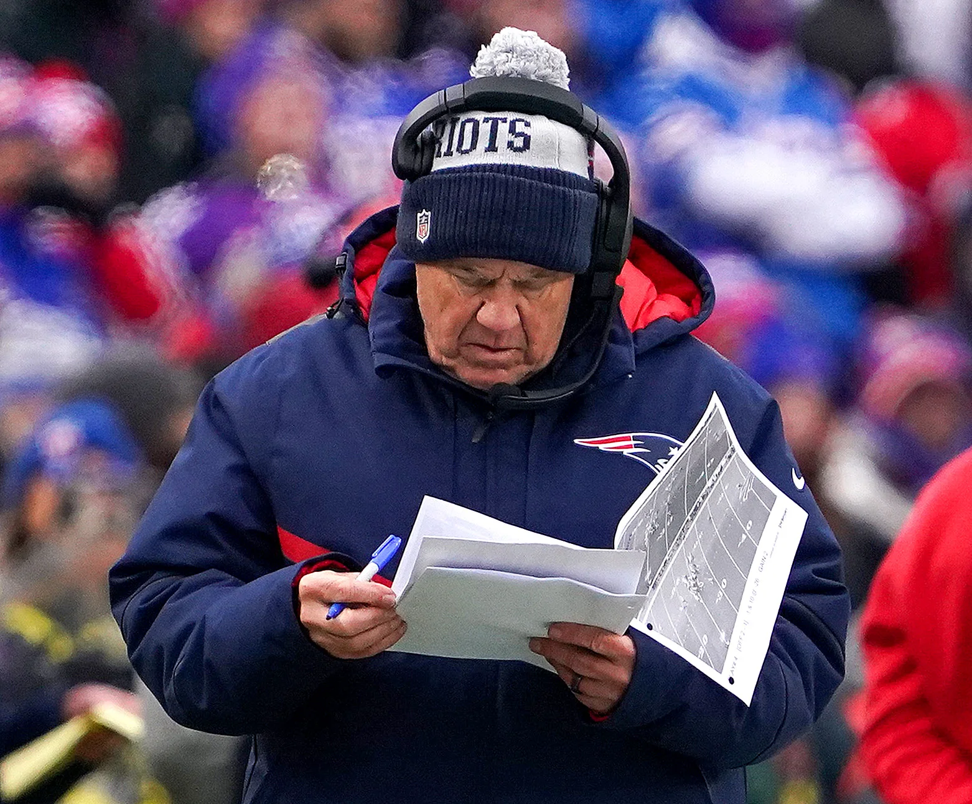

Business Understanding
Predicting whether plays will be pass or run
Useful for Defensive Strategy
Sports Gambling Applications
Notes:
Blah blah blah

Slide 3
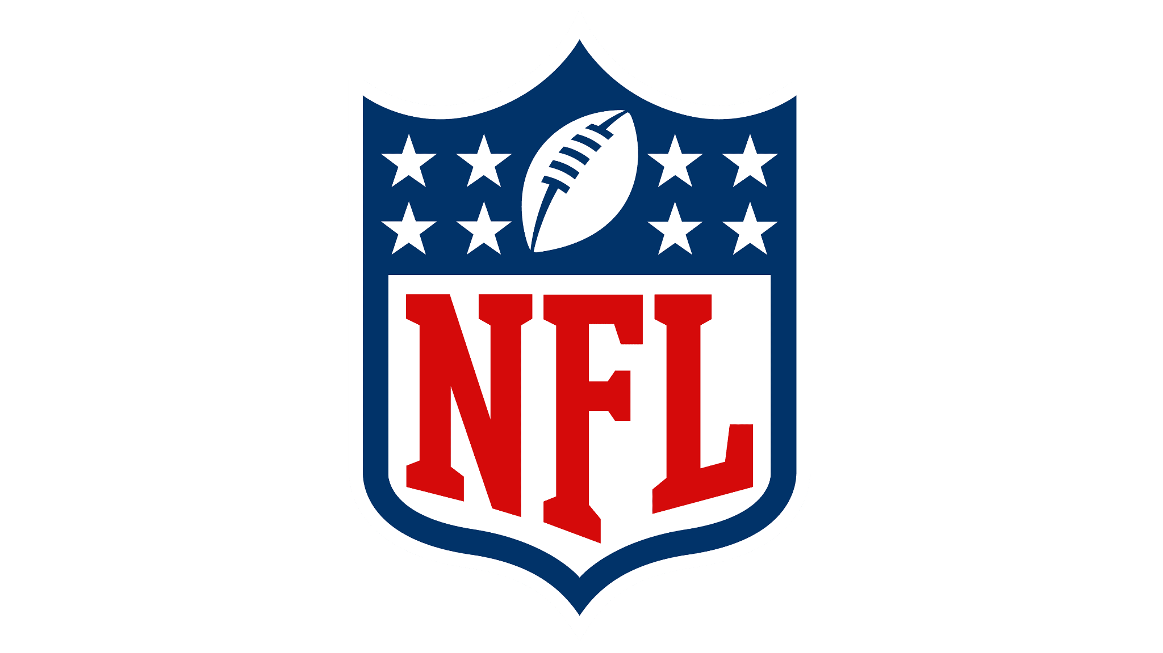
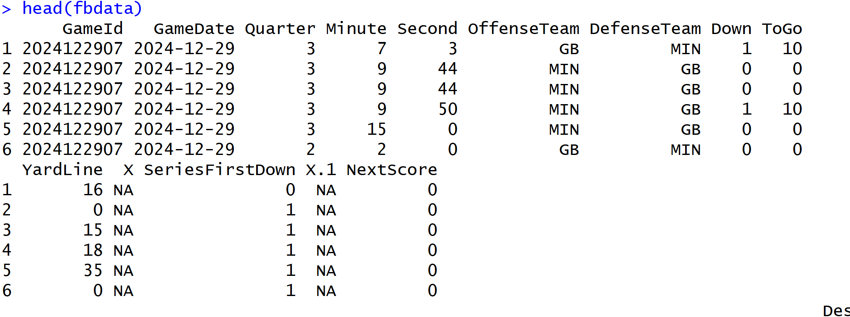
Data Understanding and Preparation
Data from NFL Savant
Play-by-Play Data from 2024 NFL Season
Filtered out Special Teams
Created New Variables

Slide 4
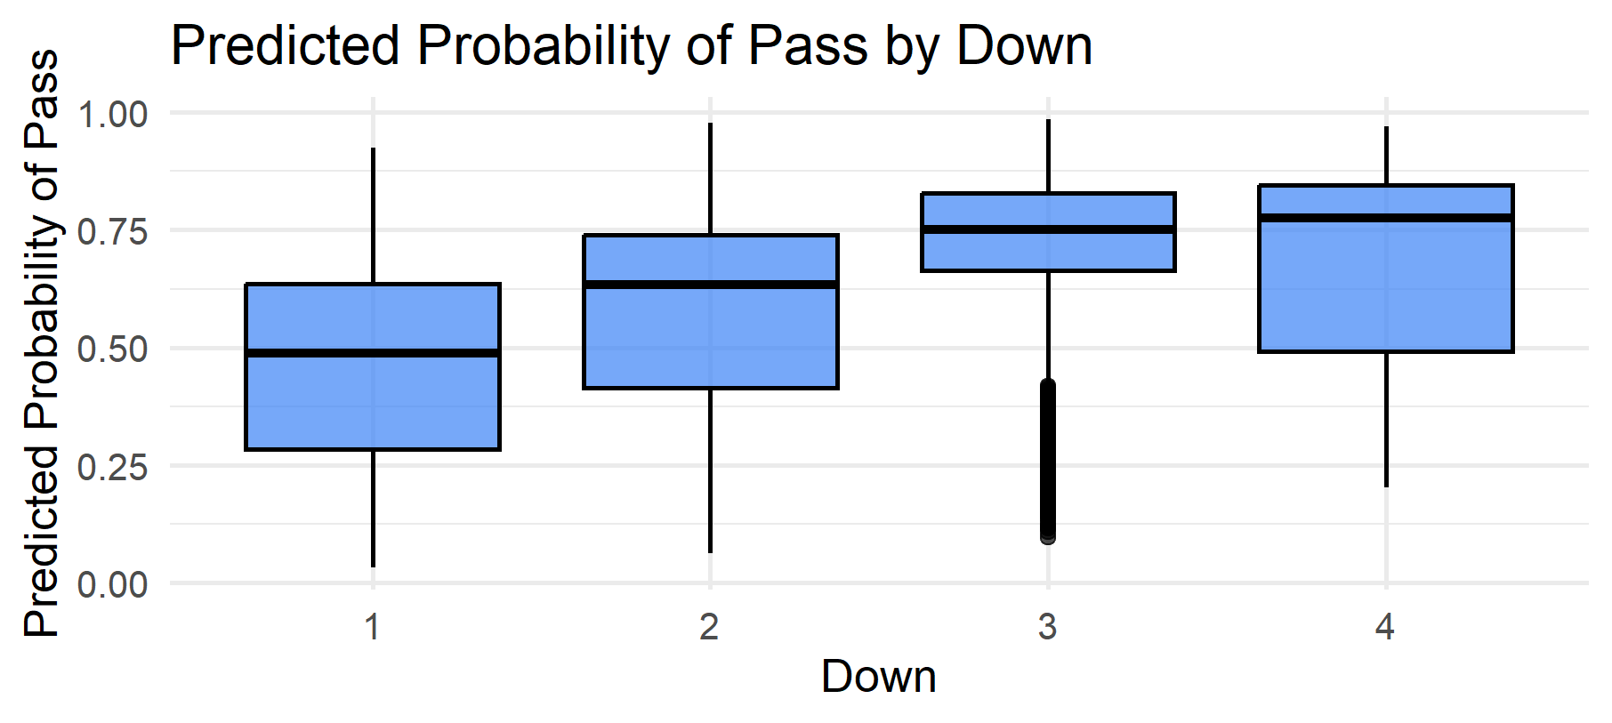
Supervised Learning- Logistic Regression
Predicting Binary Classification
Down Most Important Indicator
Strong Model Performance

Slide 5
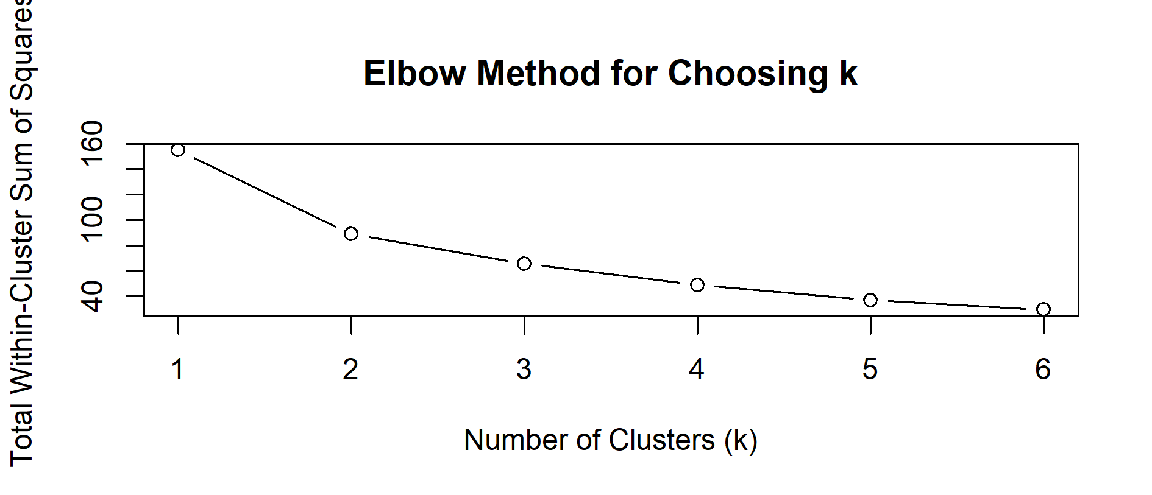
Unsupervised Learning- Cluster Analysis
Clustering Teams based on Passing Rates
Used Elbow Method for choosing amount of clusters
Compiled passing statistics from cleaned data

Slide 6
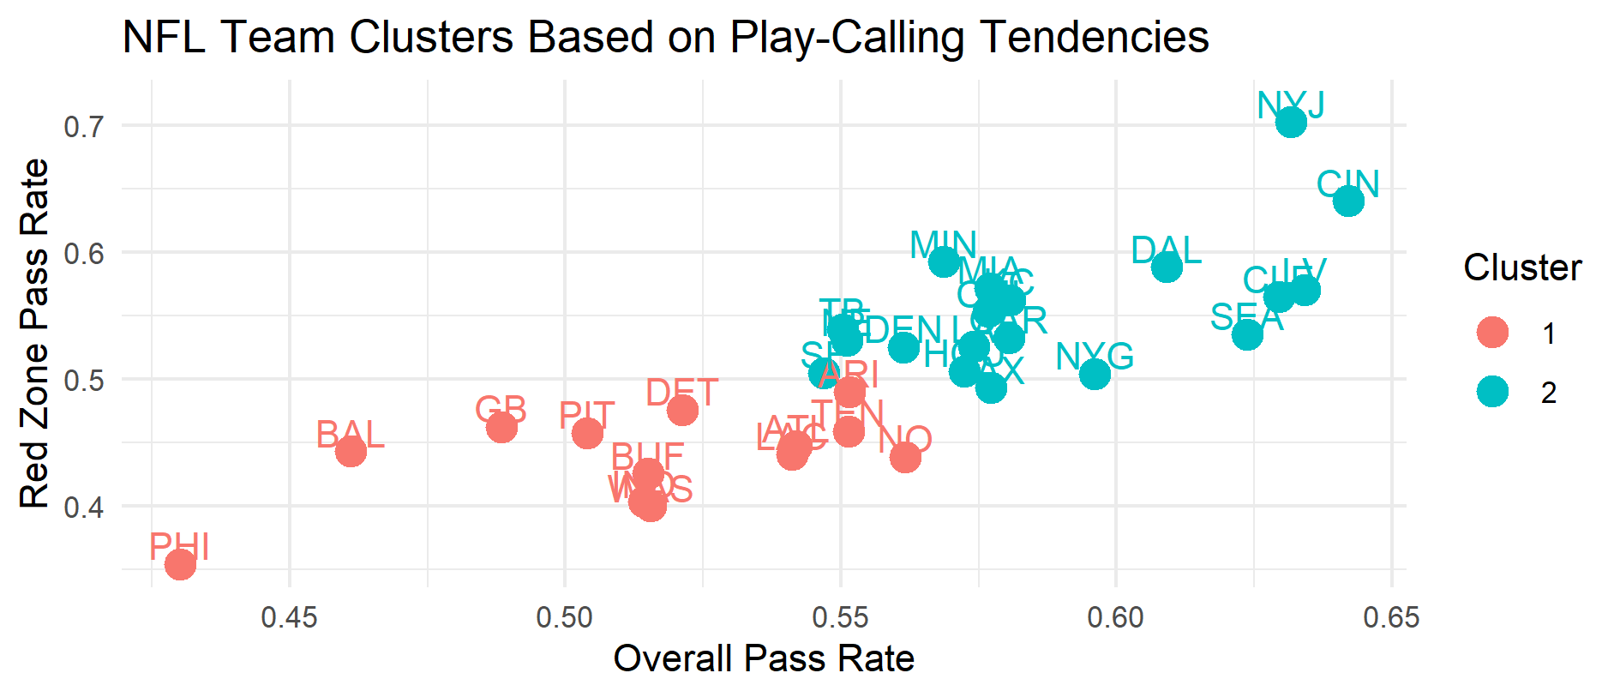
Unsupervised Learning- Cluster Analysis
Identifies Teams with similar play calling tendencies
Can incorporate into potential gameplans
Price pre-game lines more efficiently

Slide 7
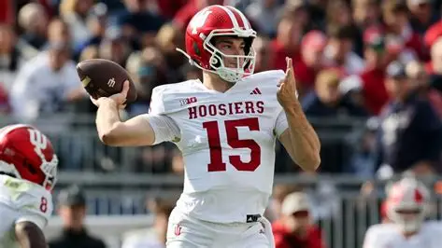
Conclusion
Successful Logistic Regression
Clustered Similar Play Calling Teams together
Useful for Football Strategy

